Slide 1

A Softcore RISC-V Vector Processor for Edge AI
23rd June 2021
V Naveen Chander
MTech Dissertation Project
Microelectronics and VLSI Design,
Supervisor: Kuruvilla Varghese
Dept. of Electronic Systems Engineering,
Indian Institute of Science

Slide 2
Objective Enabling Scalable and efficient ML inference at the edge
Develop microarchitecture for microcontroller class CPU to significantly speed up ML inference

Slide 3
Motivation
Edge computation is gaining ground with the advent of AI-IoT
Deep Neural networks are growing wider and deeper in size
Becoming increasingly difficult to deploy on conventional micro-controller-based systems
Painful trade-offs to be carried out between power, latency and accuracy.
Profiling analysis of ML inference workloads reveals that more than 99% time the CPU is busy executing matrix/vector operations
Strong need for Data-level parallelism for efficient ML inference.
Require domain-specific ISA with strong descriptive capacity for Neural Networks and support general purpose computing
RISC-V Vector (RVV) Extension defines an ISA for dealing with vectors
A vector execution unit tightly-coupled with the scalar RISC-V core can be used to enable efficient ML inference.

Slide 4
Workflow
ML Bottleneck Analysis
Identify commonly used ML inference algorithms
Microarchitecture Design
Develop a modular Vector Unit to execute Vector Instructions from RISC-V Vector ISA
Evaluation and Demonstration
Develop vectorization algorithms for neural network layers
Develop C programs for Neural Networks
Run and profile Neural Networks to identify portions of code where CPU spends the maximum time
Interface the Vector Unit with a microcontroller class RISC-V host processor
Run programs on Scalar and Vector RISC-V CPUs
Compare performance of Vector core with scalar core and other data-parallel microcontroller cores
Implement design on Xilinx Vertex-7 FPGA
Demonstrate Image Classification task on the vector processor

Slide 5
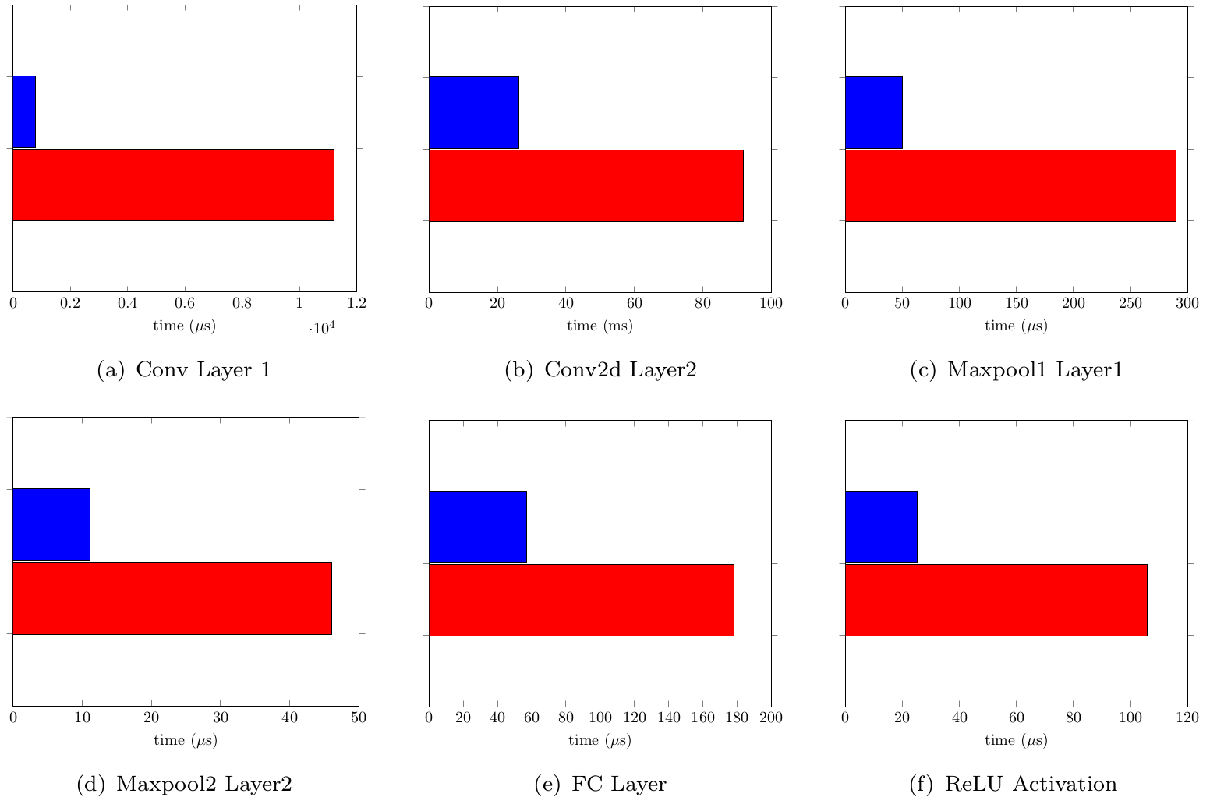
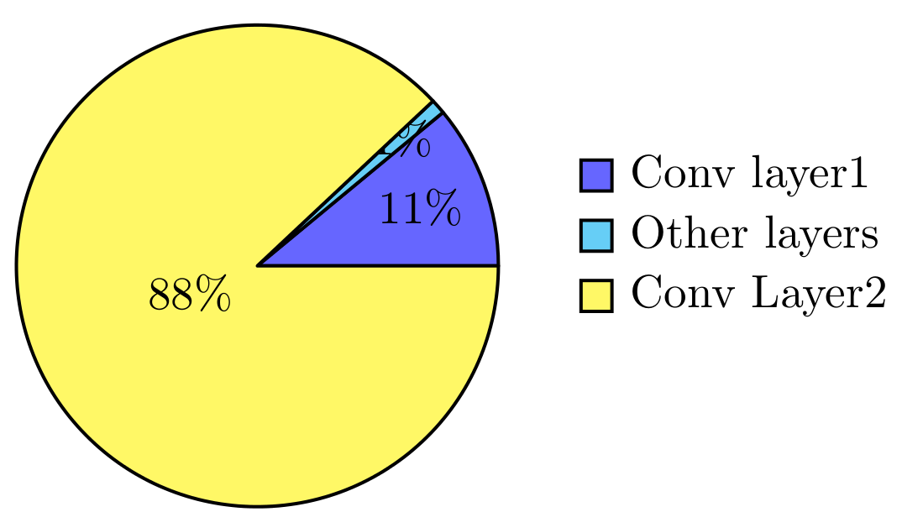
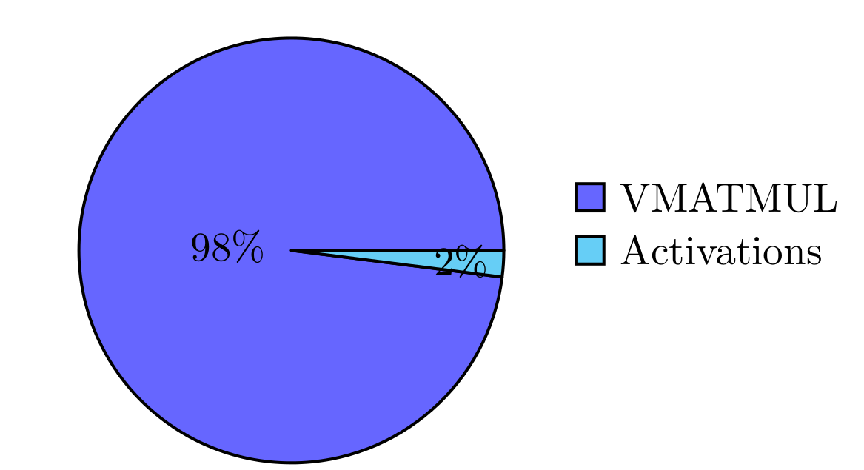
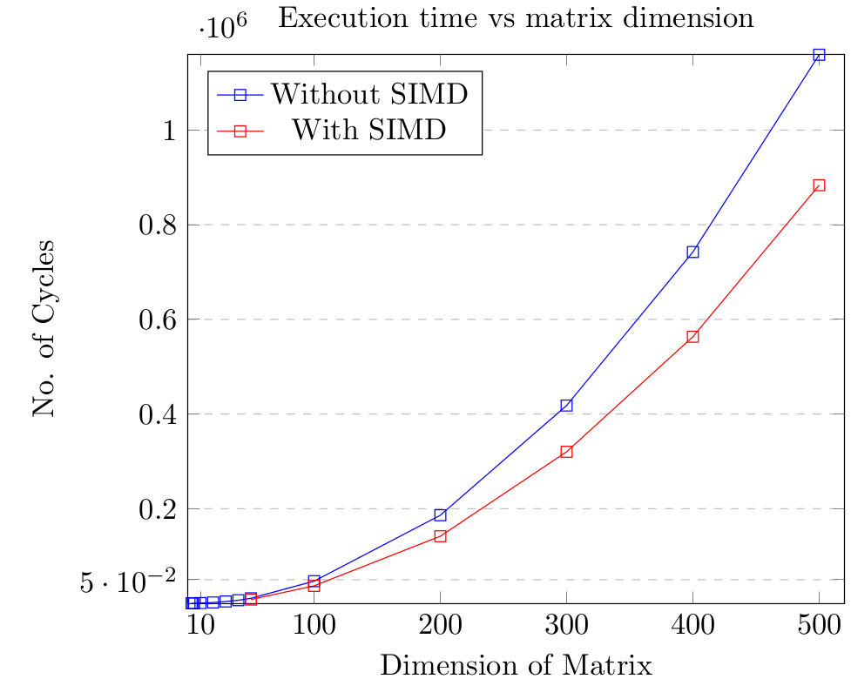
Computational Bottlenecks in ML
14.5x
3.5x
5.8x
C-code profiling was carried out for MLP, CNN, PCA, AE, RNN, LSTM on x86 and ARM targets
Findings :-
Many NN topologies have some common operations such as -
Matrix Vector Multiplication in MLP, CNN, RBM, AE, PCA, RNN, LSTM
Matrix Convolution → Vector Dot Product in all CNNs, Capsule Networks
Vector Multiplication with Scalar
Exponent Computation of elements in a vector
In all NNs, >99% time, CPU is busy with Matrix/Vector operations
4.1x
3.1x
3.1x
Without SIMD
With SIMD
Effect of SIMD on Execution Time on Intel i386 CPU for a 6-layer CNN
Distribution of Execution Time on CNN (left) and RNN(right)
KEY TAKEAWAY
Need to exploit the data-level parallelism in ML inference
Effect of SIMD on performance of Matrix Vector Multiplication

Slide 6
Related Work
Topology | Pros and Cons
Hardware ML Accelerators | Fastest and Most energy-efficient; but lack support for Gen. purpose ISA
Multi-core and Many core CPUs | Good speedup, poor energy efficiency as they fail to exploit Data Level Parallelism in ML
Data-parallel CPUs such as SIMD and Vector | Exploit DLP. Can achieve significant speedups with minimal energy overheads
VEGAS
2009, Soft Vector Processor IP
FPGA based Softcore Vector Processor targeted at Image Processing Applications
Operates at 100 MHz and Features a scratchpad Memory and a decoupled Vector Unit
Klessydra-T
2021, Vector Processor for Edge-AI
3 cores, 105 MHz with vector Unit with Scratchpad Memory on FPGA
Although Host CPUs are RISC-V Cores, Vector Unit does not use RVV
PULP CE32V40
2017, Low-power Data-parallel SIMD CPU
OpenRISC Core ASIC with DSP extensions
Use SIMD unit with custom instructions to handle vectors
Targeted at 8-bit, 16-bit computations
Ongoing project on RISC-V Vector CPU for Edge-AI
British Computer Society Open Source Specialists
Studied Workload of ML-inference and arrived at the similar conclusions
Use RISC-V Vector Unit with PULP CE32V40
Demonstrated speed-ups at the level of Functional Simulation on FPGA (12th February, 2021)

Slide 7
RISC-V Vector Extension ISA Specification
RVV-ISA is a document that defines the ISA for RISC-V vector extension
ISA is yet to be ratified. The current Vector Processor design adheres to spec. Ver 1.0
Features
RISC-V ISA is open and free for use
No licensing requirements
RISC-V ISA is modular
RISC-V Vector (RVV) Extension is exhaustive
RVV allows users to choose subsets of the extension to be implemented
Allows usage of General purpose and Vector Instructions together
RVV Overview
Organization of Data in Vector Registers
Instructions for Vector Loads and Stores
Instructions for Vector Arithmetic Operations → 300 + instructions
Vector Reduction Instructions
Vector Permutation Instructions
This work uses 53 vector instructions to accelerate ML inference

Slide 8
Specifications of the RISC-V Vector CPU
Parameter | Specification
CPU | Single-core, single-issue, in-order, 5-stage pipeline
Operating Frequency | 50 MHz
Memory | I-Cache : 8KB , 2-way Set Associative D-Cache : 8KB, 2-way Set Associative Main Memory : 1MB
ISA Support | RV32gV
Peripheral | UART (1 port)
Vector Accelerator | 8-lane Integer Vector Unit Vector Memory: 128kB Scratchpad memory
Power Consumption | 597 mW
CLK
XILINX VERTEX-7
XC7VX485TFFG1761-2
FPGA
featuring
RISC-V Vector CPU
Soft-IP
RST
CTS
RTS
UART_RX
UART_TX

Slide 9

Microarchitecture
Vector Execution Model and Theoretical performance
Vector Execution Unit microarchitecture and results
Integration of Vector Unit to Host CPU

Slide 10
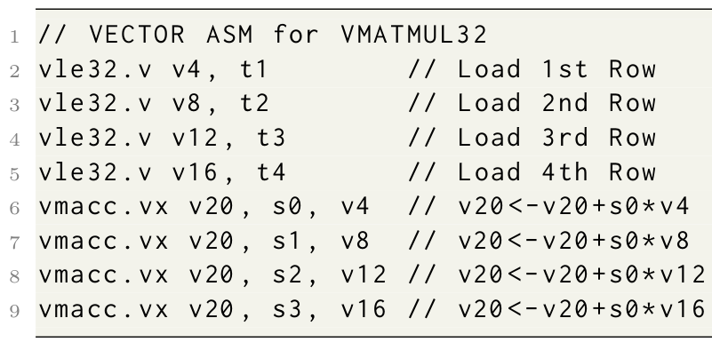
Vector Execution Model
Vector Arithmetic Units operate on Vectors that are stored in a Vector Register File.
Assume we have a 6-stage pipeline: Fetch→ Decode→ Read→ Execute→ Memory-> Write back
Assume, we have an 8-lane Vector Processor
vle32.v v4, t1
F
D
R
E
M0
M1
M2
…
M31
W31
Lane1
vle32.v v8, t2
CONVOY
F
D
R
E
M0
M1
M2
…
M31
W31
Lane2
vle32.v v8, t2
F
D
R
E
M0
M1
M2
…
M31
W31
Lane3
vle32.v v8, t2
F
D
R
E
M0
M1
M2
…
M31
W31
Lane4
vmacc.vx v20, s0, v4
F
D
R
E0
E1
E2
…
E31
M31
W31
Lane5
vmacc.vx v20, s1, v8
F
D
R
E0
E1
E2
…
E31
M31
W31
Lane6
vmacc.vx v20, s2, v12
F
D
R
E0
E1
E2
…
E31
M31
W31
Lane7
vmacc.vx v20, s3, v16
F
D
R
E0
E1
E2
…
E31
M31
W31
Lane8
Total Vector Execution Time = 44 Cycles; Chime Estimate=32 cycles; Overheads = 12 cycles

Slide 11
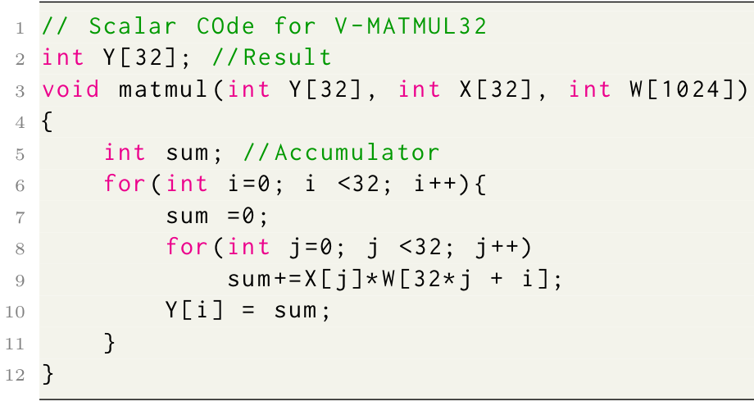
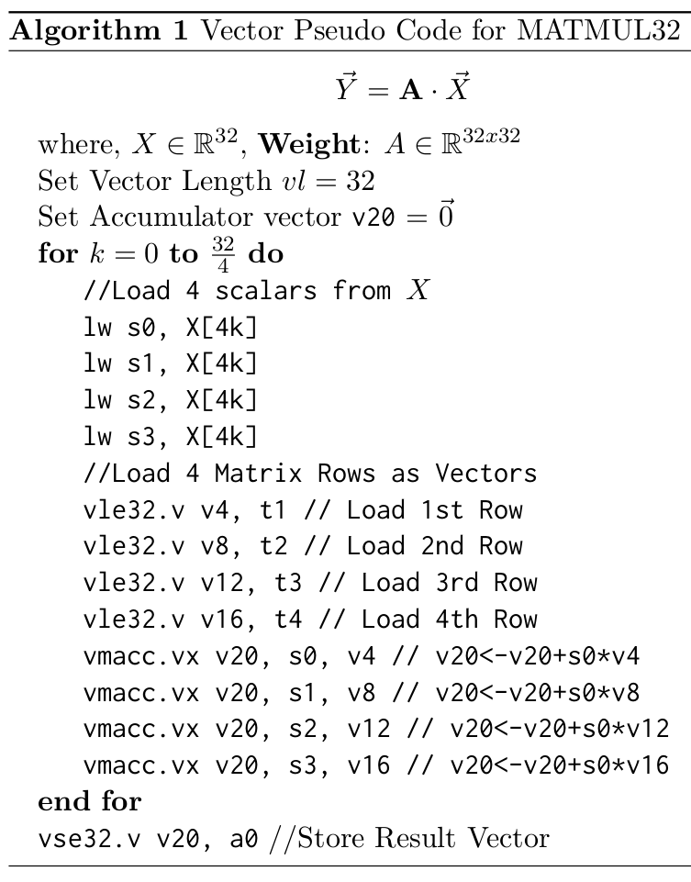
Analytical measurement of Performance on VMATMUL32
Scalar Core
Assume an ideal scalar processor that has CPI=1
All Cache-hits and no hazards in pipeline
Runs a fully optimized assembly code for VMATMUL
Vector Core
Can operate up to eight elements per cycle
Takes 44 cycles to execute 32 elements
Vectorization results in 8 convoys
Scalar instructions run at CPI = 1
Parameter | Scalar Core | Vector Core
No. of Static Instructions | 17 | 22
No. of dynamic Instructions | 7626 | 145
Cycles to execute | 7630 | 520
Ideal Speedup | 1 | 17.6
Deviations from Ideal Condition that contribute to variation in Speedup
I-Cache, D-Cache Miss Penalties
Hazard Penalties
Handshaking cycles(only for Vector Proc)

Slide 12
Design of RISCV-Vector Execution Unit
Novel Architecture with
Systolic Array execution unit
Scratchpad memory based Vector Memory Unit
Systolic Array based Vector Execution
Network of eight identical processing elements
Use shared resources such as Register files and memory
Execution of P.Es is tightly coupled => P.E != HART

Slide 13
BLOCK SCHEMATIC OF PIPELINED VECTOR EXECUTION UNIT
Lane 1
Lane 2
Lane 3
Lane 4
Lane 5
Lane 6
Lane 7
Lane 8
WB_FIN
MEM_WB
DMEM Bank 0
DMEM Bank 1
DMEM Bank 2
DMEM Bank 3
DMEM Bank 4
DMEM Bank 5
DMEM Bank 6
DMEM Bank 7
EXE_MEM
P.E
P.E
P.E
P.E
P.E
P.E
P.E
P.E
RD_EXE
X- BAR
RA
RB
W
RA
RB
W
RA
RB
W
RA
RB
W
RA
RB
W
RA
RB
RA
RB
RA
RB
VRF
Bank 0
32 x 32
Elements
0, 8, 16, 24, …
VRF
Bank 1
32 x 32
Elements
1, 9, 17, 25, …
VRF
Bank 2
32 x 32
Elements
2, 10, 18, 26, …
VRF
Bank 3
32 x 32
Elements
3, 11, 19, 27, …
VRF
Bank 4
32 x 32
Elements
4, 12, 20, 28, …
W
W
W
VRF
Bank 1
32 x 32
Elements
5, 13, 21, 29, …
VRF
Bank 2
32 x 32
Elements
6, 14, 22, 30, …
VRF
Bank 3
32 x 32
Elements
7, 15, 23, 31, …

Slide 14
Block Schematic of Scalar RISC-V Pipeline
RS1_FWD + IMM32
+
IF/ID.PC + IMM32 - 4
+
ID/EX
EX/MEM
MEM/WB
WB/FIN
RS1+IMM32
PC + IMM32
PC+4
PC
CONTROL
+
00
<<1
01
10
REG_FILE
R0-R31
00
11
11
00
01
00
I-MEM
01
10
ZERO
CLK_EN
10
10
D-MEM
1
PC
REG
11
ZERO
NOP
11
01
ALU
D
ADDR
1
I(19:15)
DT1
D_FA
BLU
ADDR
0
RD#1
ZERO
DOUT
0
I(31:0)
I(24:20)
RD#2
DT2
00
00
00
DOUT
FOUR
memreg
WR#
01
01
01
c_hazard
RWR
10
10
10
DIN
CLK
DATA_IN
11
01
ALUop
11
1
dmr
dmw
E_FB
ALUSrc
0
D_FB
M_FB
rd
rwr
IF/ID
IMM32
GEN

Slide 15
FROM SCALAR TO VECTOR PIPELINE
Vector Interface Unit
VRF
BANK 7
v0-v31
32-bit
V-MASK UNIT 7
VRF
BANK 7
v0-v31
32-bit
V-MASK UNIT 7
VRF
BANK 7
v0-v31
32-bit
V-MASK UNIT 7
VRF
BANK 7
v0-v31
32-bit
CHAINING
V-MASK UNIT 7
ALU 7
32 bit
Instruction – 0→7
RD#1
DT1
ALU 7
32 bit
RD#1
DT1
ALU 7
32 bit
RD#2
DT2
ALU 7
32 bit
RD#1
DT1
.
.
.
.
.
.
RD#2
DT2
RD#1
WR#
DT1
DT1_Xbar
RD#2
MASK
WR#
DT2
RD#2
MASK
RWR
DT2
WR#
MASK
DT2_Xbar
RWR
WR#
DATA_IN
RWR
MASK
DATA_IN
DT3_Xbar
RWR
DT3
DATA_IN
DT4_Xbar
DATA_IN
DT4
1
.
.
.
1
1
x1
1
0
D-MEM
Bank 7
1k x 32
0
D-MEM
Bank 7
1k x 32
0
D-MEM
Bank 7
1k x 32
0
D-MEM
Bank 7
4k x 32
ALU 7
32 bit
ADDR
SYSTOLIC
ARRAY
SEQUENCER
STALLER
ALU 7
32 bit
DOUT
.
.
.
ALU 7
32 bit
ADDR
DOUT
LSU 7
32 bit
ADDR
DOUT
ADDR
DOUT
CHAINING
DIN
DIN
x3
DIN
dmr
dmw
dmr
dmw
DIN
dmr
dmw
x4
dmr
dmw
WB/FIN
ID/RD
RD/EXE
EXE/MEM
MEM/WB
x2

Slide 16
Systolic Array Sequencer
Functions
Distributes Instructions to Vector Lanes
Schedules Execution
Distributes Shared Resources
Design
Hierarchical Sequencer
Each Vector Lane has a micro sequencer
The top level sequencer coordinates execution of all eight micro sequencers

Slide 17
SYSTOLIC ARRAY SEQUENCER –LANE SEQUENCER
Lane 1
Lane 2
Lane 3
Lane 4
Lane 5
Lane 6
Lane 7
Lane 8
X- BAR X3
DMEM Bank 0
DMEM Bank 1
DMEM Bank 2
DMEM Bank 3
DMEM Bank 4
DMEM Bank 5
DMEM Bank 6
DMEM Bank 7
X- BAR X2
P.E
X- BAR X1
RA
RB
W
RA
RB
W
RA
RB
W
RA
RB
W
RA
RB
W
RA
RB
RA
RB
RA
RB
VRF
Bank 0
32 x 32
Elements
0, 8, 16, 24, …
VRF
Bank 1
32 x 32
Elements
1, 9, 17, 25, …
VRF
Bank 2
32 x 32
Elements
2, 10, 18, 26, …
VRF
Bank 3
32 x 32
Elements
3, 11, 19, 27, …
VRF
Bank 4
32 x 32
Elements
4, 12, 20, 28, …
W
W
W
VRF
Bank 1
32 x 32
Elements
5, 13, 21, 29, …
VRF
Bank 2
32 x 32
Elements
6, 14, 22, 30, …
VRF
Bank 3
32 x 32
Elements
7, 15, 23, 31, …

Slide 18
Vector Memory
Scratchpad memory based on SRAM
Capacity 128 kB (4k x 4 x 8)
Latency of 1 clock cycle
Organized as 8 banks
Controlled by programmer
Mainly used for storing vectors
Shown to provide 1.2x – 3x performance improvement over cache
WE
WE
WE
WE
WE
WE
WE
WE
DIN[31:0]
DOUT[31:0]
DIN[31:0]
DOUT[31:0]
DIN[31:0]
DOUT[31:0]
DIN[31:0]
DOUT[31:0]
DIN[31:0]
DOUT[31:0]
DIN[31:0]
DOUT[31:0]
DIN[31:0]
DOUT[31:0]
DIN[31:0]
DOUT[31:0]
ADDR[11:0]
ADDR[11:0]
ADDR[11:0]
ADDR[11:0]
ADDR[11:0]
ADDR[11:0]
ADDR[11:0]
ADDR[11:0]
0
0
0
0
0
0
0
0
SPRAM
Bank 4
16 KB
SPRAM
Bank 5
16 KB
SPRAM
Bank 6
16 KB
SPRAM
Bank 7
16 KB
SPRAM
Bank 0
16 KB
SPRAM
Bank 1
16 KB
SPRAM
Bank 2
16KB
SPRAM
Bank 3
16 KB
1
1
1
1
1
1
1
1
2
2
2
2
2
2
2
2
4095
4095
4095
4095
4095
4095
4095
4095

Slide 19
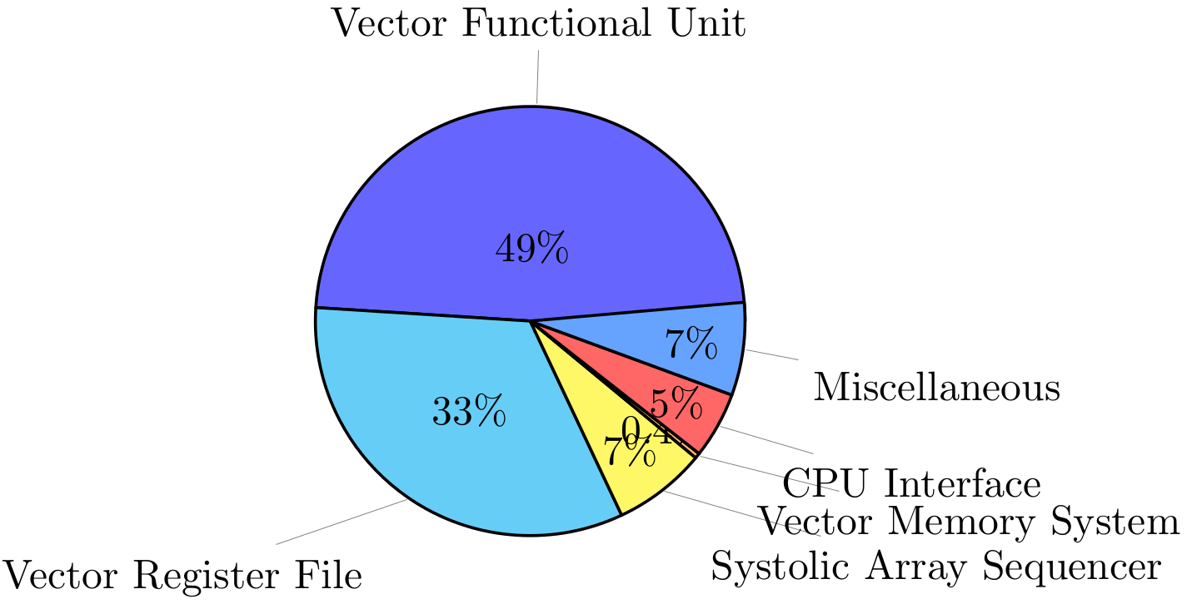
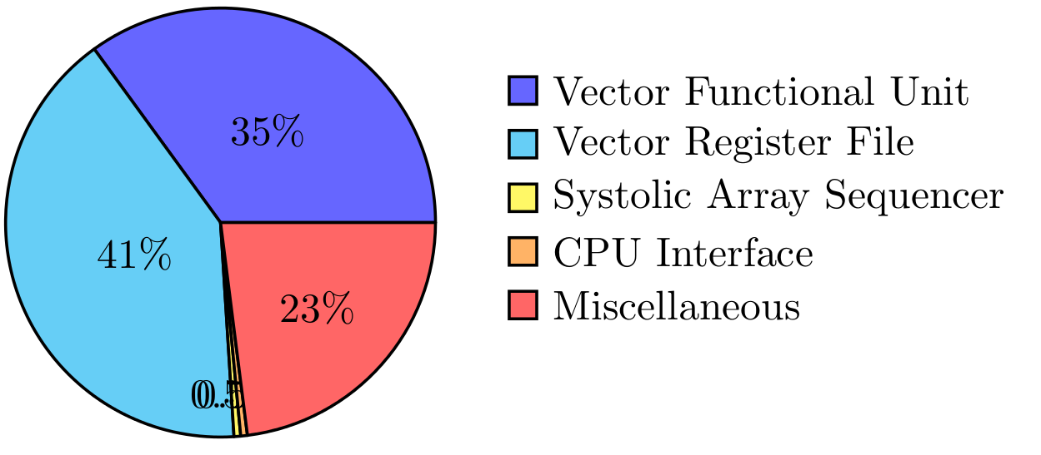
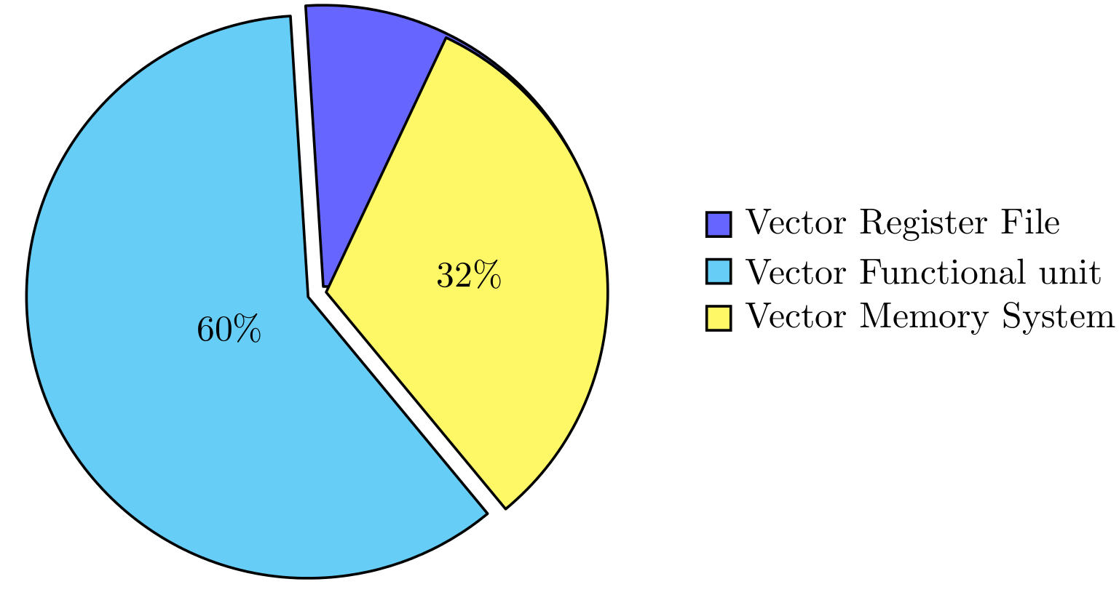
Implementation Results of Standalone Vector Unit
LUT Distribution
Registers Distribution
Total Power : 120 mW
Power Distribution

Slide 20
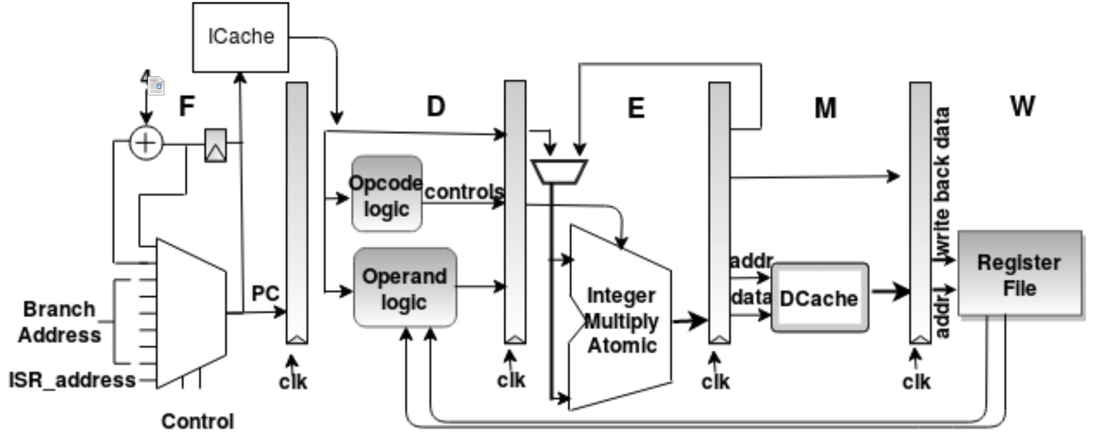
Integration of Vector Unit
HOST CPU
Host CPU
Microcontroller class softcore with 1MB RAM and UART peripheral
Single core, 5-stage, single-issue, in-order CPU
Parameter | Specification
CPU | Single-core, single-issue, in-order, 5-stage pipeline
Operating Frequency | 50 MHz
Memory | I-Cache : 8KB , 2-way Set Associative D-Cache : 8KB, 2-way Set Associative Main Memory : 1MB
64
32
ADDR, DATA_WR, RD,WR
66
32
H-SHAKE
xREG_DATA
DATA_RD
PC_CTRL
INSTRUCTION
V_BUSY
Vector Interface Unit (VIU)
Scratchpad Memory
and
Vector
Register
Interface
Interface
Tightly Coupled Integration → Vector Unit is attached onto the Host CPU’s pipeline
Uses Native Bus Interface for low latency communication
Vector and Scalar execute in a mutually exclusive manner using handshake signals
VIU directly receives the instruction read from the Memory for decoding
Additionally the host CPU has access to Vector Register File and Vector Memory
DECODED_OPRNDS,CTRL
118
START
STALL
DONE
PIPELINED VECTOR UNIT
iBuf0
iBuf1
iBuf2
…
iBuf7
Vector Read Stage R
Vector Execute Stage E
Vector Memory Stage M
Vector Write-back Stage W
Lane1
Lane2
Lane3
Lane8

Slide 21
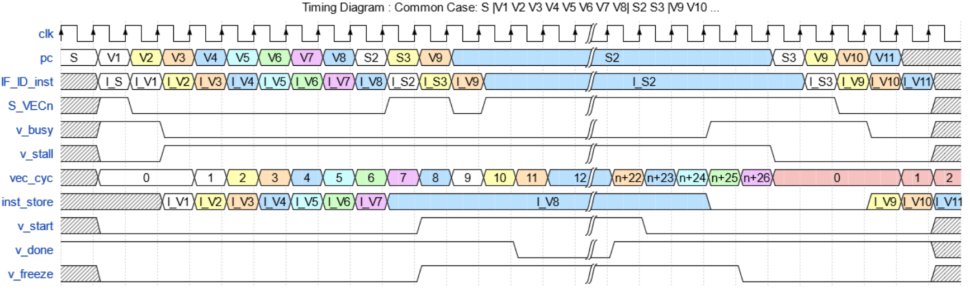
VIU Sequencer
INSTRUCTION
S1
S2
V1
V2
V3
V4
V5
V6
V7
V8
S3
S4
S5
S6
S7
S8
SCALAR PIPELINE
S
S
S
S
S
S
S
S
S
S
S
S
S
S
S
S
VECTOR PIPELINE
V
V
V
V
V
V
V
V
V
V
V
V
V
V
V
V

Slide 22
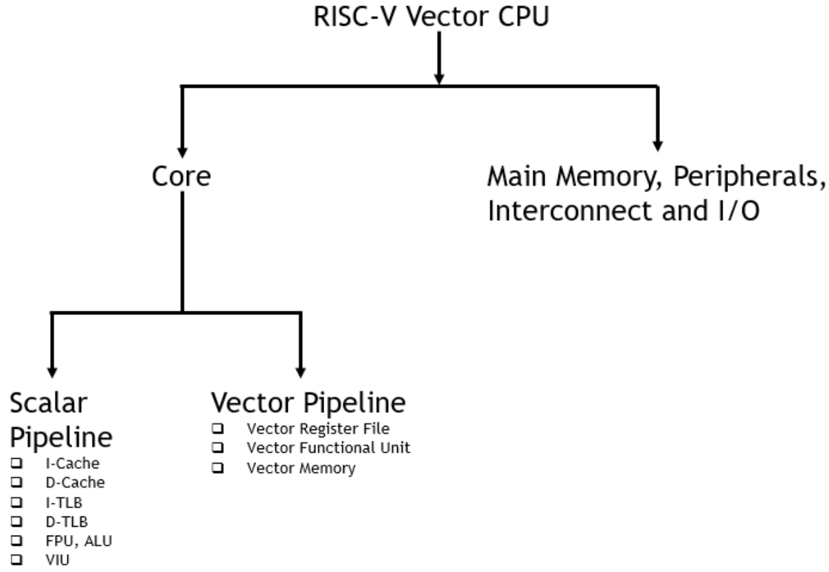
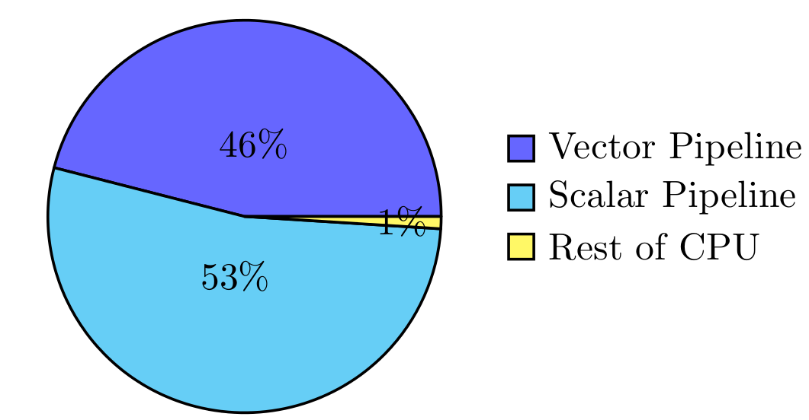
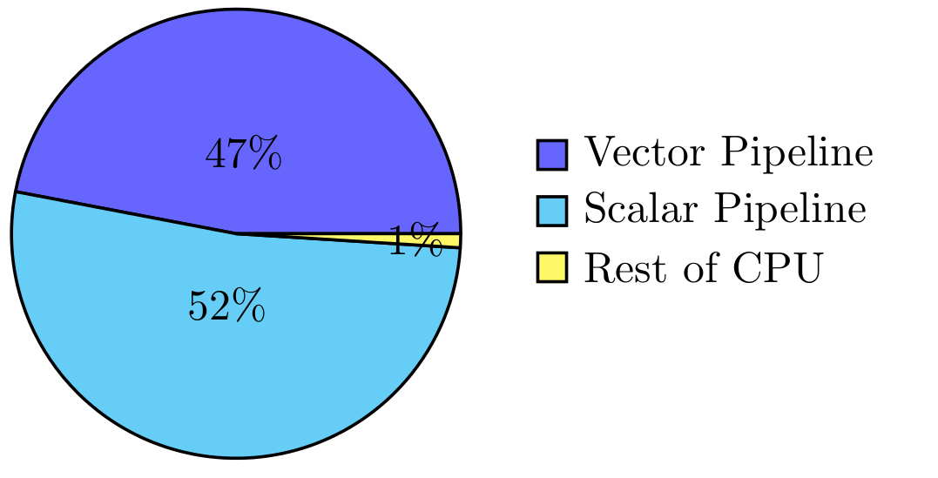
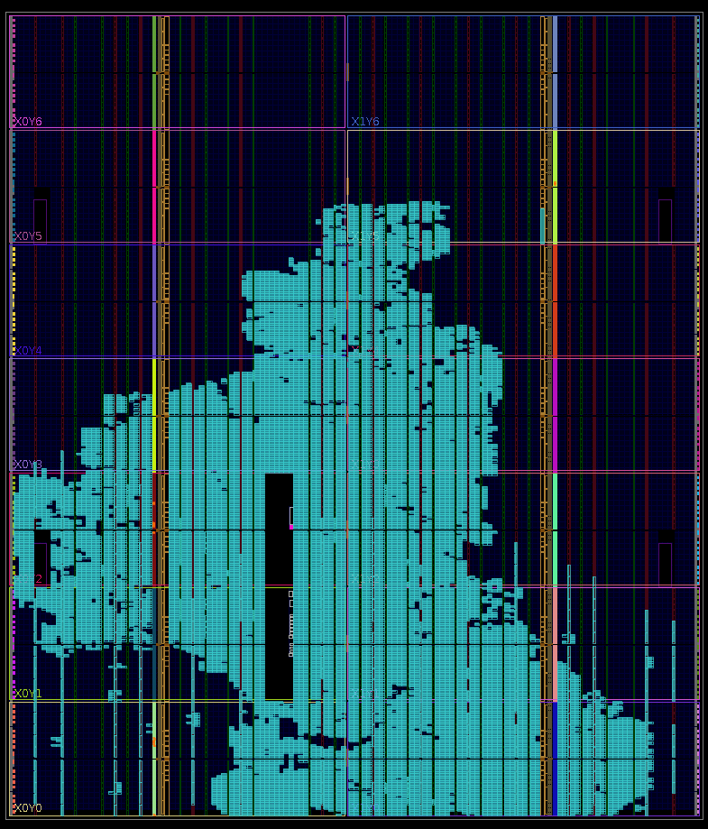
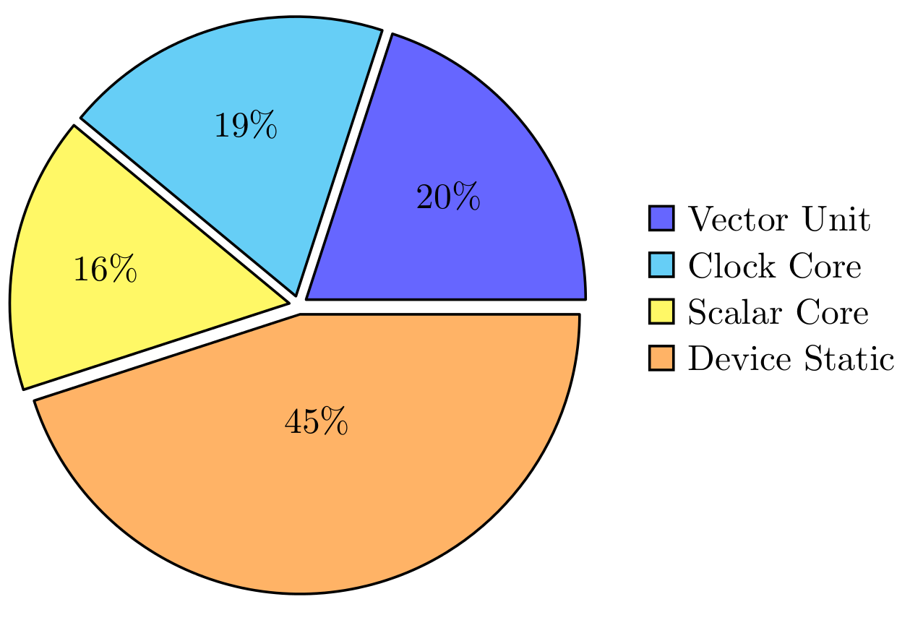
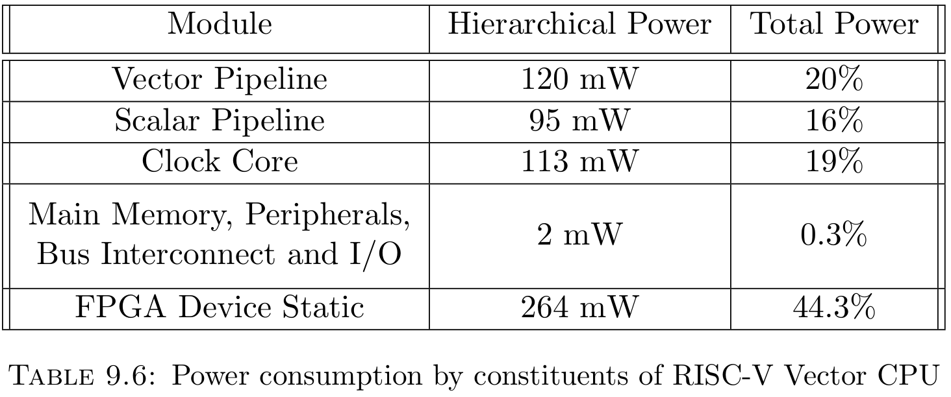
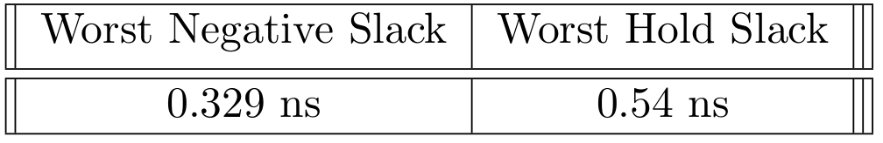
Top Level Design
Resource Utilization
Power Consumption
Power Estimation
FPGA Device die view post Implementation on Xilinx Vertex-7 xc7vx485tffg1761-2 FPGA
Overall Resource Utilization ~ 26%
Vectored Power Estimation using Xilinx Power Analyser by running CNN on CPUs in Post-layout Simulations
Timing Analysis
On-chip Power | Static | Dynamic | Total
Vector CPU | 264 mW | 333 mW | 597 mW
Scalar CPU | 263 mW | 233 mW | 496 mW

Slide 23
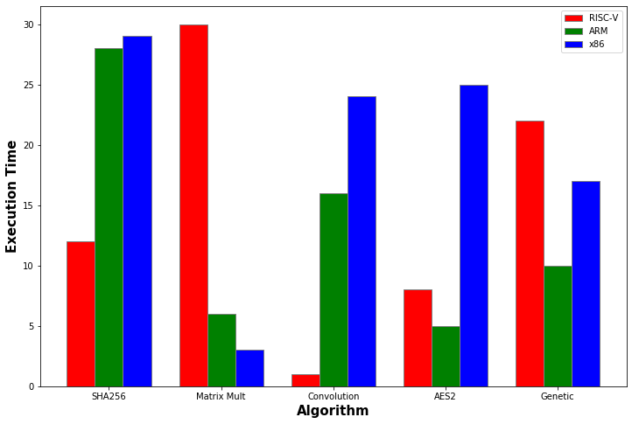
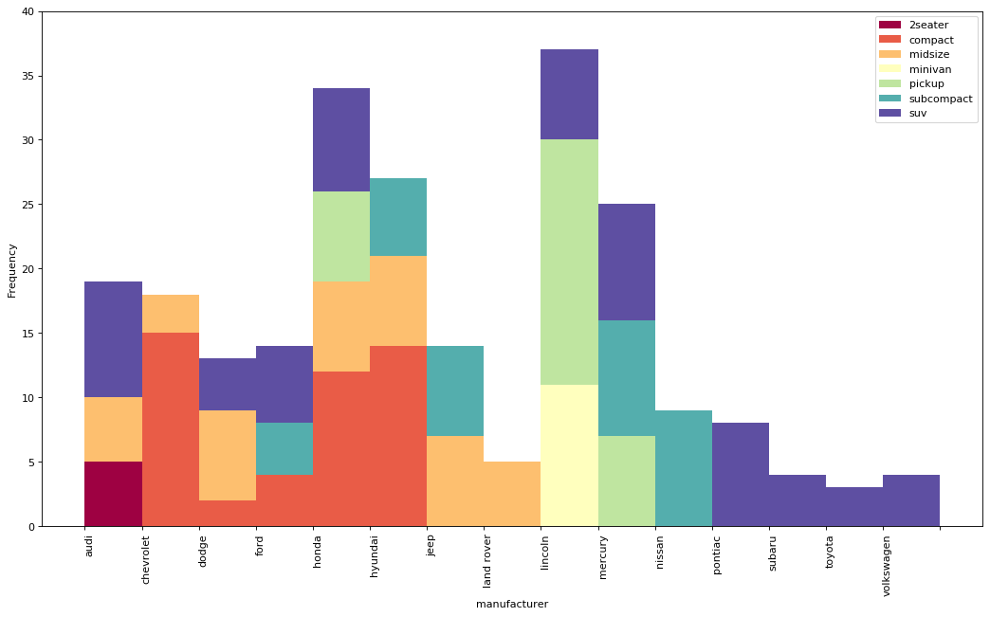
Evaluation
Benchmarking
Demonstration on Image Recognition task

Slide 24
Evaluation Plan
Evaluation Metrics
Average cycle count per algorithmic operation
Maximum Clock Frequency
Absolute Execution Time
Average Energy per algorithmic operation
Comparison
Scalar vs Vector: All benchmark programs run on Scalar and vector Cores
RISCV-V Vector vs. other Data parallel machines:
Klessydra-T (softcore)
Vector Processor with 3 HARTS
105 MHz with Vector Unit and Scratchpad Memory
Targeted at Edge-AI (2021)
CE32V40 (ASIC)
Ultra-low power SIMD processor by PULP Platform
91.4 MHz
Targeted at data-parallel computations (2017)
Criteria
Performance
Power
Benchmarking
Custom suite of programs devised
Based on identified computational workloads
30 programs under 6 classes
Vector Programming
Devised Vectorization Algorithms for benchmark kernels
Enable programmer write codes that make efficient use of hardware.
RVV Assembly with C-wrapper function

Slide 25
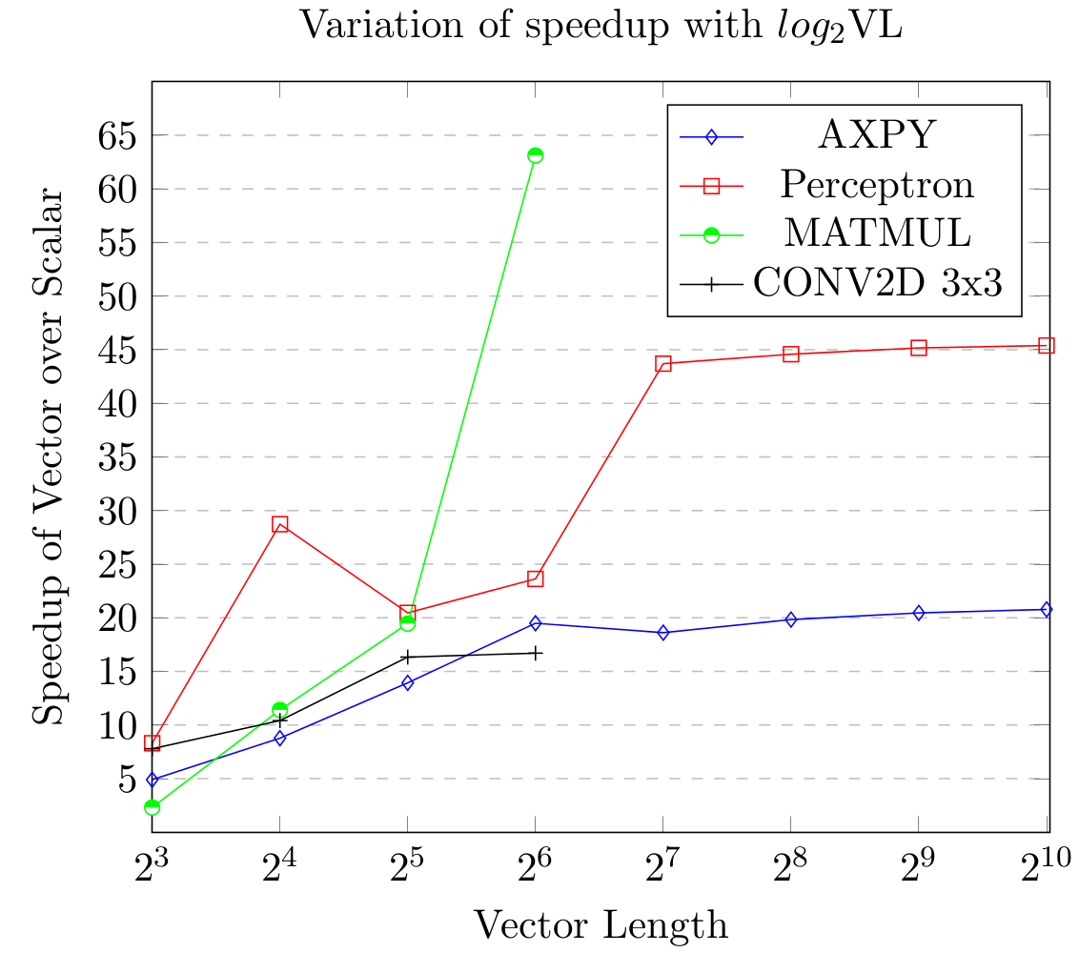
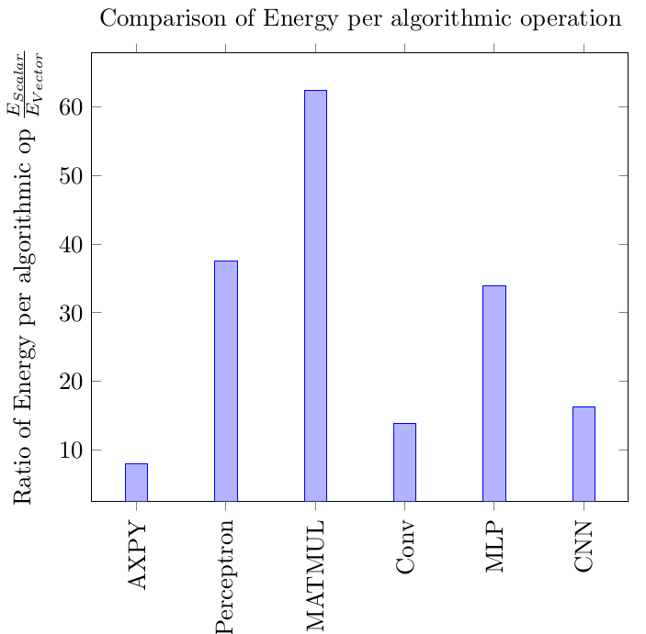
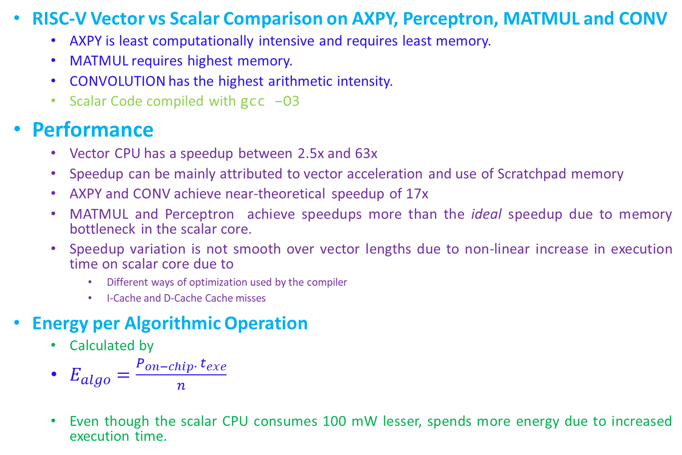
Benchmarking Results
RISC-V Vector vs Scalar Comparison on AXPY, Perceptron, MATMUL and CONV
AXPY is least computationally intensive and requires least memory.
MATMUL requires highest memory.
CONVOLUTION has the highest arithmetic intensity.
Scalar Code compiled with gcc –O3
Performance
Vector CPU has a speedup between 2.5x and 63x
Speedup can be mainly attributed to vector acceleration and use of Scratchpad memory
AXPY and CONV achieve near-theoretical speedup of 17x
MATMUL and Perceptron achieve speedups more than the ideal speedup due to memory bottleneck in the scalar core.
Speedup variation is not smooth over vector lengths due to non-linear increase in execution time on scalar core due to
Different ways of optimization used by the compiler
I-Cache and D-Cache Cache misses
Energy per Algorithmic Operation
Calculated by
$E_{algo}=\frac{P_{on−chip}. { t}_{exe}}{n}$
Even though the scalar CPU consumes 100 mW lesser, spends more energy due to increased execution time.

Slide 26
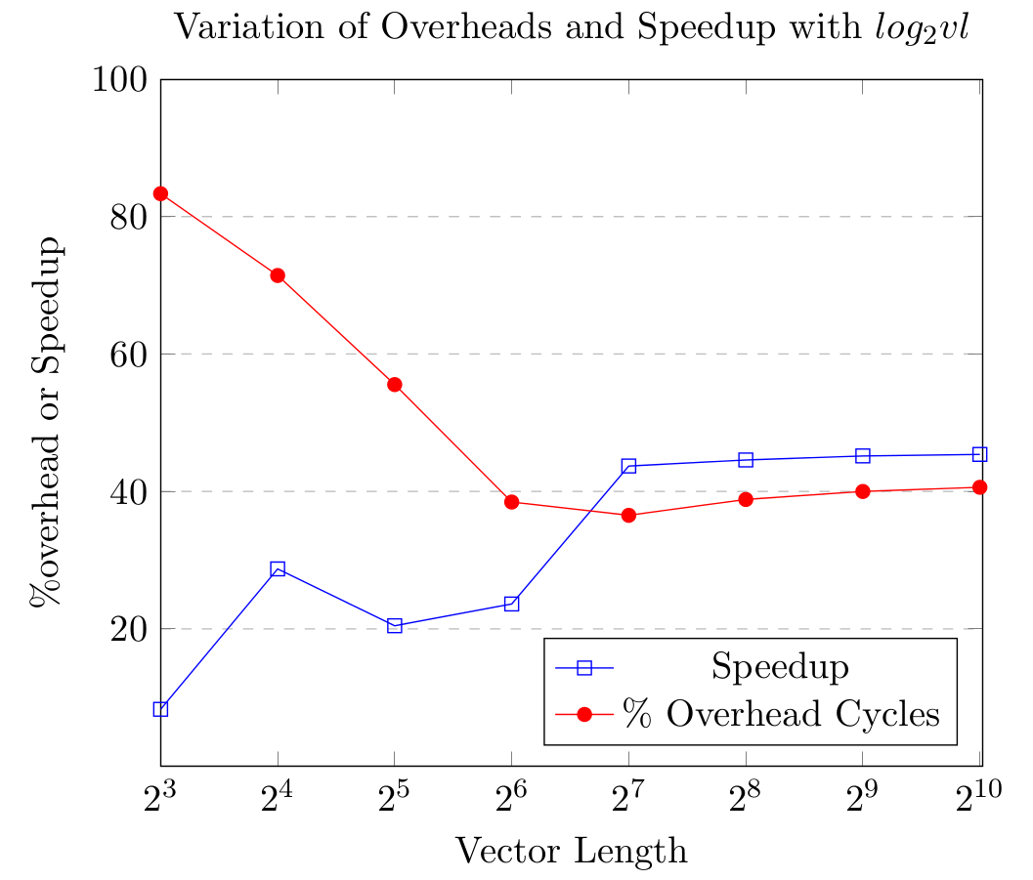
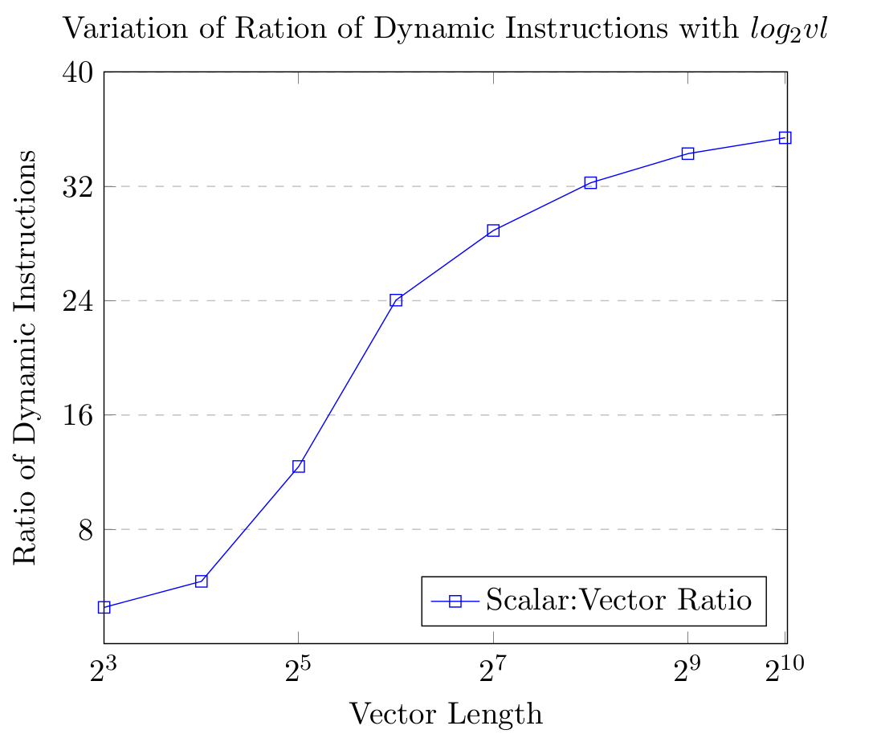
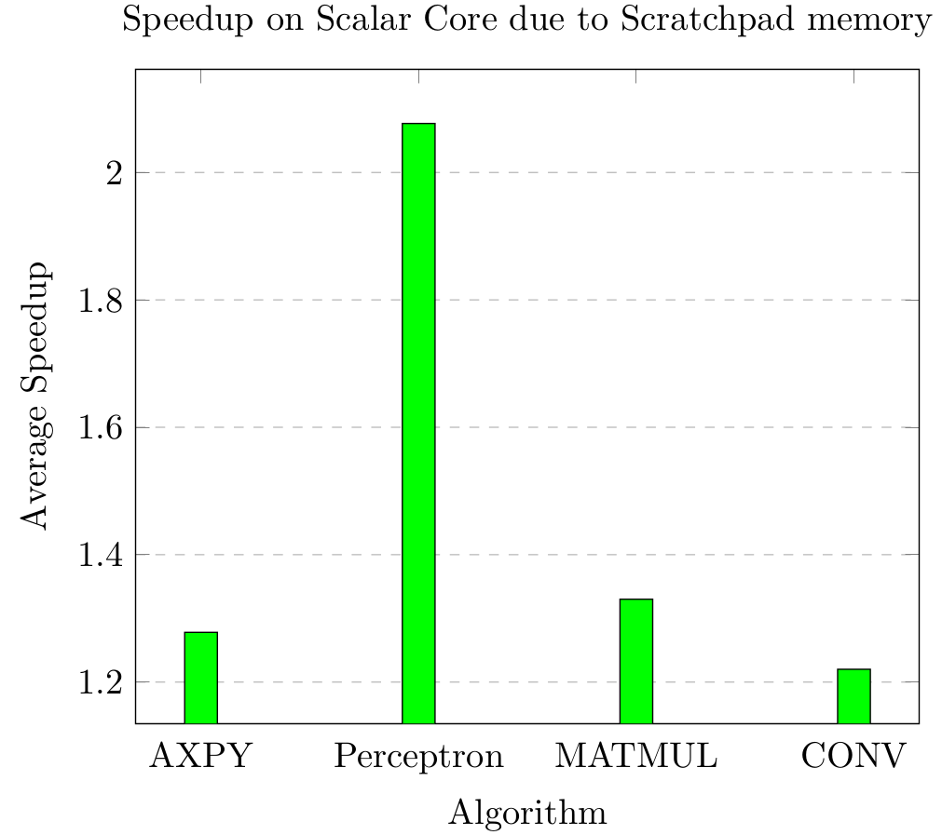
Speedup variation with Vector length
Speedup increases with vector length before it begins to saturate
Low speedup for small vectors can be attributed to
High vector unit overheads
Better compiler optimization for scalar code
Reduced probability of cache miss
Accounting for speedup
About 17x is the theoretical speed-up
Due to increased number of instructions and data fetched by the scalar core, it loses many cycles in miss penalties (miss penalty=23 cycles)
About 1.3x -2.5x speedup is contributed by using Scratchpad Memory

Slide 27
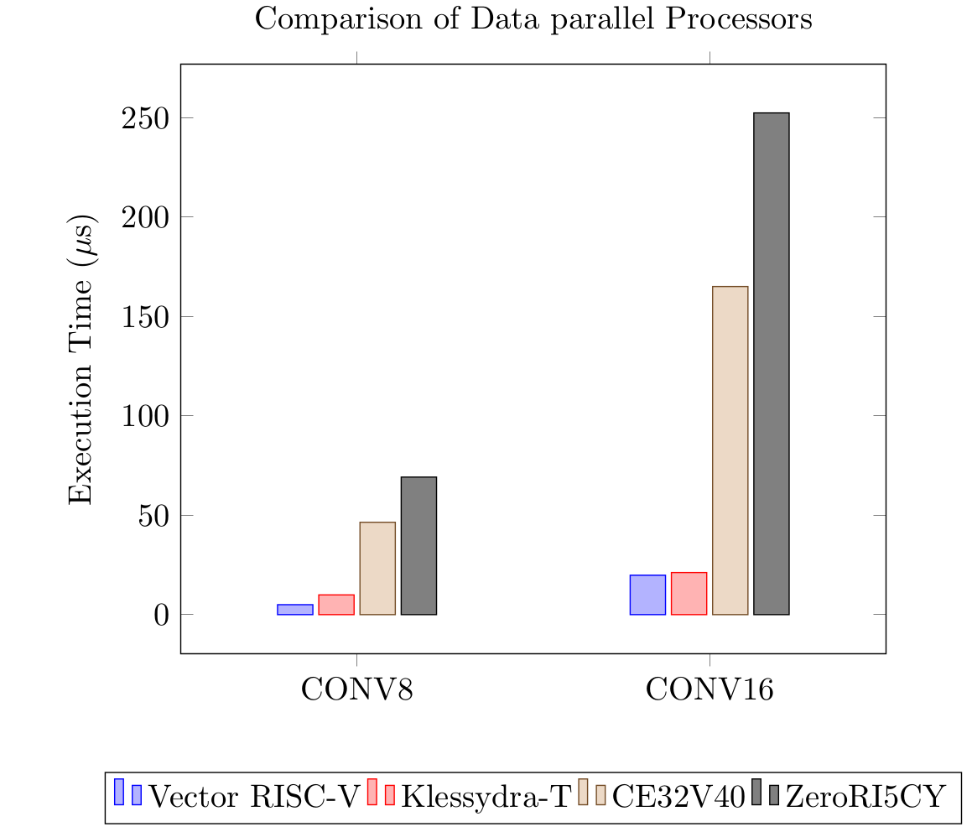
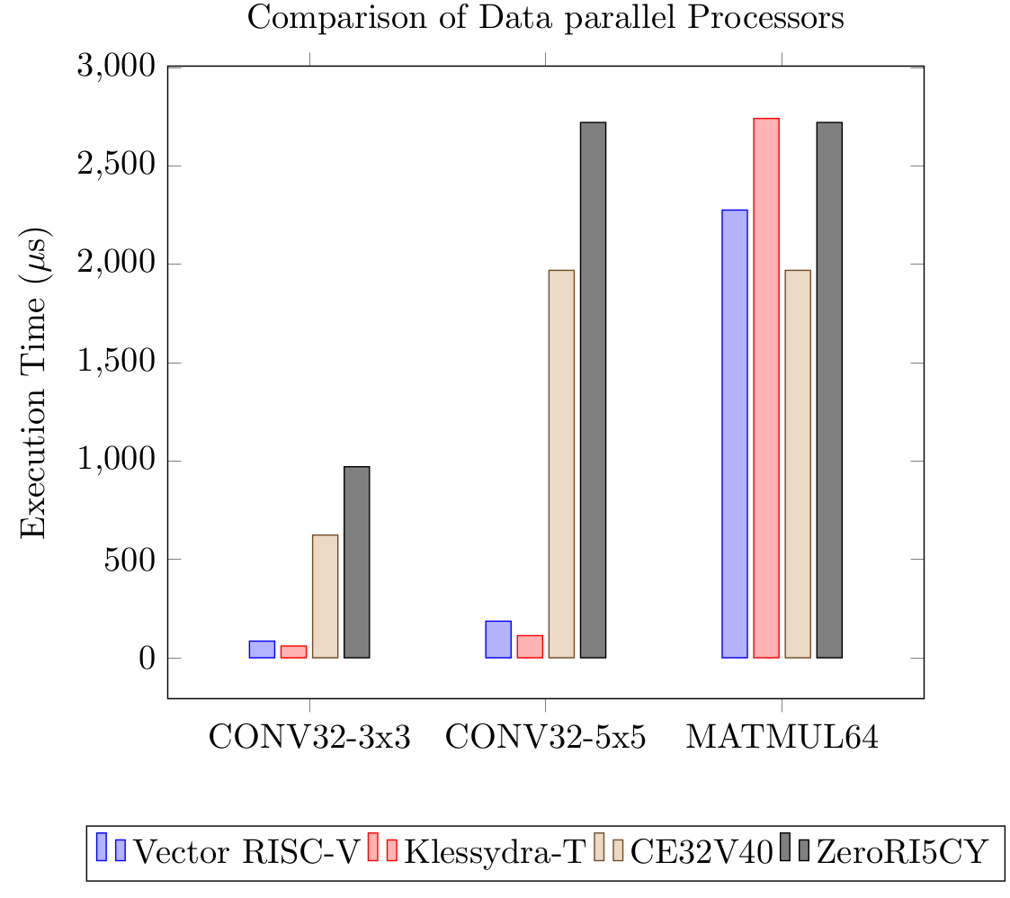
Comparison with Other Data-parallel Processors
RISC-V Vector CPU performs comparably with Klessydra Vector Processor
RISC-V Vector CPU performs better than SIMD processor on Convolution, but SIMD has an edge over Vector processor on MATMUL64

Slide 28
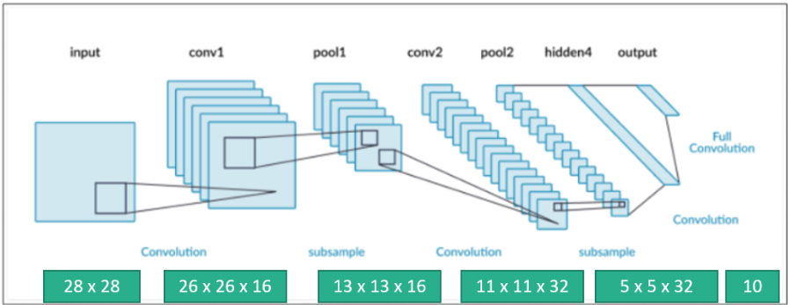
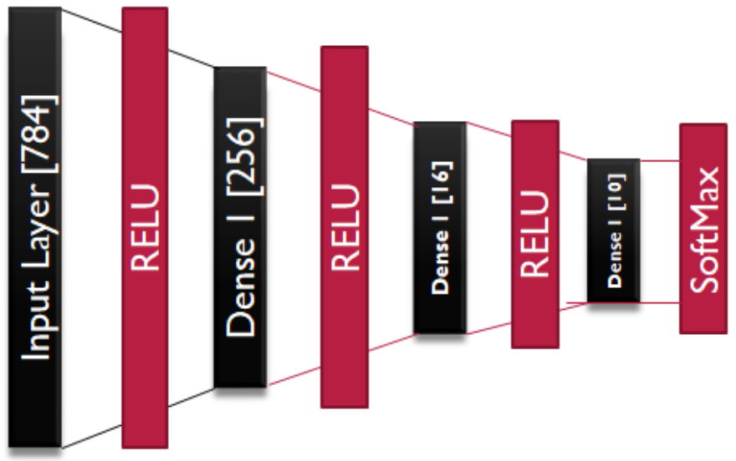
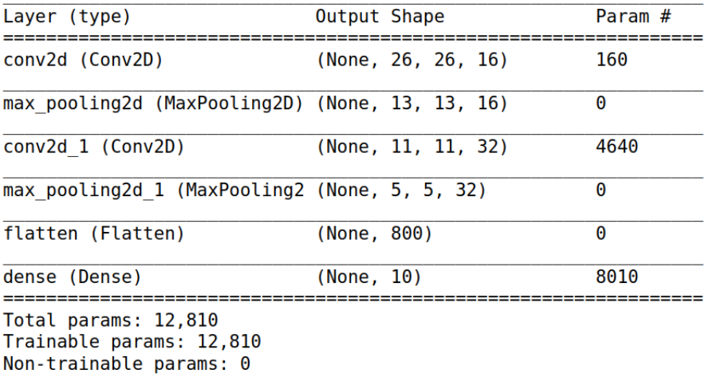
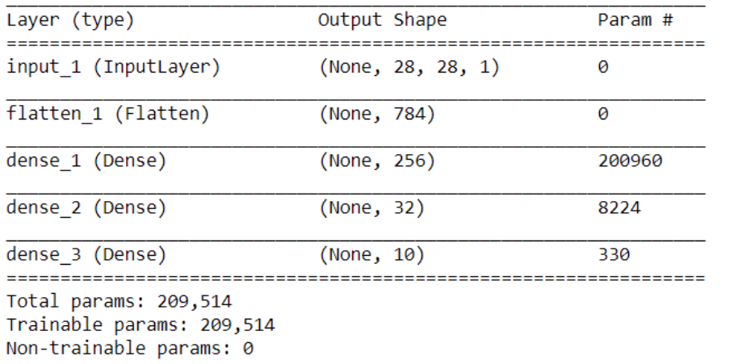
Performance on Neural Networks
Multi layer Perceptron
Convolutional Neural network
SPEEDUP: 40.7x
SPEEDUP: 19.53x
ENERGY IMPROVEMENT: ~ 33x
ENERGY IMPROVEMENT ~ 16x

Slide 29
Summary and Future Work
Main Contributions
Future Work
Bottleneck analysis of ML Inference
A microarchitecture for efficient ML inference on microcontroller class CPUs
Tightly coupled Vector Execution Unit
Benchmark targeted at ML workloads
Vectorization Algorithms for kernels commonly encountered in ML inference
Support for low precision vector arithmetic
8-bit/16-bit numbers multiply performance without much loss in accuracy
DMA for Scratchpad memory
Avoid CPU time to be wasted in copying data from amin memory to scratchpad memory
Increased Clock Frequency of operation
Make changes in the host such as remove FPU, change Cache-replacement algorithm to increase operating frequency above 50 MHz
Mixed Signal Accelerators
The developed Vector Interface is robust, and the vector unit is modular.
The present vector unit can be replaced with an Analog Accelerator designed in the future

Slide 30
Demonstration: Handwritten Digit Recognition by Vector Processor
Demo Video /Demo Action

Slide 31
THANK YOU

